Slide 1

CMR COLLEGE OF ENGINEERING & TECHNOLOGY
Kandlakoya, Medchal, Hyderabad - 501401
Department of Computer Science and Engineering
FLORA IDENTIFICATION
BATCH NO :41
Name of the student
20H51A05D8 –B.PRAVEEN
20H51A0532 -B.NARESH
20H51A05M6 –V.VAMSHI
Under esteemed guidance of
Dr.P.SENTHIL
(Assistant Professor)

Slide 2
Outline
Abstract
Introduction
Literature survey
Existed system
- Problems in existed system
Research Objective of Presentation
Problem Definition
Research work
- Proposed system architecture
- Methods
- Comparison of Proposed system with an existed system
Performance Measure
Results
Conclusion
Future Work

Slide 3
Abstract

Slide 4
ABSTRACT
Plant plays an important role in agricultural, industrial, medicine, environmental and ecological protection. Recently, with global warming, biodiversity loss, rapid urban development and environmental damage, people have been seriously destroying the natural environments, which results in that a large number of plant species constantly dying and even dying out every year. It is essential to protect plant species. The first step of protecting plants is to recognize them and understand what they are and where they come from. But there are a large number of plant species that have been named on Earth, and many are still unknown yet, it is difficult to identify each species. To handle such huge information, develop a quick and efficient classification method has become significant research.
Plant species can be recognized by its leaf, flower, skin, fruit and seed, etc. Relatively speaking, using leaf to recognize plant species is very simple and convenient, and may leaf based plant species recognition methods have been proposed. In this paper, we mainly summarize the existing leaf based plant species identification methods, including plant leaf characteristic, public databases, feature extraction-based methods, subspace learning based methods, sparse representation-based methods, and deep learning-based methods. The aim is to emphasize the importance of plant species identification, train people to know about plant species, and provide guidance and comprehensive study for the beginners in this field, in turn, to treasure and protect plant species.

Slide 5
INTRODUCTION

Slide 6
Introduction
Flora Identification has received a great attention from the machine learning and machine vision communities. There are many challenges that need to be overcome in order to have a reliable plant recognition method that could be used in serious industrial applications. The problem of plant species recognition can be seen as two separate problems, based on the goal that we want to achieve. The first problem can be defined as recognizing the presence of a certain plant on an image (retrieval problem), and the second problem is finding a certain type of plant in an image and segmenting it from the image.
Plant Taxonomy is a science to separate plants into similar groups based on the characteristics like colour of the flower, shape of the flower, leaf shape and form, fruits, bark of the stem etc. Plant recognition when done manually by specialized taxonomists, suffers from perceptual biasness, cost of hiring of experts and shortage of experts. The process of manual taxonomy becomes time consuming and tedious when more and more images are added to the database. Automation of the recognition process can improve the time, efficiency, accuracy and cost associated with the recognition process. This has given rise to the demand of automatic tools for plant species recognition and classification.

Slide 7
Literature Survey

Slide 8
Literature survey
1.Define the research scope: Determine the specific aspects of flora identification that you want to focus on, such as machine learning algorithms, image processing techniques, or specific plant species. 2.Identify relevant databases: Identify and explore relevant academic databases, such as IEEE Xplore, ACM Digital Library, Google Scholar, or botanical databases, to search for scientific articles, conference papers, and other relevant literature. 3.Search keywords: Develop a list of keywords and phrases related to flora identification, such as "plant species recognition," "machine learning in botany," "image-based plant classification," and use them to search for relevant literature in the selected databases. 4.Refine search results: Refine and filter the search results based on relevance, publication year, and the specific objectives of your project. Consider including both recent publications and seminal works to ensure a comprehensive review. 5.Citations and references: Keep track of all the relevant citations and references for the publications you have reviewed. Ensure that you properly cite and credit the authors of the works you have included in your literature survey.

Slide 9
Existed system
Plant Taxonomy is a science to separate plants into similar groups based on the characteristics like colour of the flower, shape of the flower, leaf shape and form, fruits,bark of the stem etc. Plant recognition when done manually by specialized taxonomists, suffers from perceptual biasness, cost of hiring of experts and shortage of experts. The process of manual taxonomy becomes time consuming and tedious when more andmore images are added to the database. Automation of the recognition process can improve the time, efficiency, accuracy and cost associated with the recognition process.
This has given rise to the demand of automatic tools for plant species recognition and classification. Major support system for the automation is availability of digitized databases with high resolution plant images annotated with species names and metadata like date and time, long information aided by high resolution cameras available on handheld devices. The current approaches for plant species identification utilize only leaf form and shape. The reason being that leaves due to their shape and size, have the advantage to be easily observed, captured and described and are less effected by seasonal changes.

Slide 10
Problems with Existing System
Plant species recognition based on flower identification remain a challenge in Image processing and Computer Vision community mainly because of their vast existence, complex structure and unpredictable variety of classes in nature. Because of these natural complexities, it is highly undesirable to perform normal segmentation or feature extraction or combining shape, texture and colour features which results in moderate accuracy on benchmark datasets.
Although some feature extraction techniques combining global and local feature descriptors reaches state of the art accuracy in classifying flowers, still there is a need for a robust and efficient system to automatically identify and recognize flower species at a larger scale in complex environment. With a large number of images to identify and a lack in manpower, a method to achieve the same in easier ways is one of the leading researches in the world right now.

Slide 11
Research objective
.
Species classification: Develop accurate and efficient machine learning models or algorithms for automated species classification based on plant images.
Image dataset creation: Collect and curate a comprehensive and representative dataset of plant images with corresponding species labels for training and evaluation purposes.
Transfer learning: Explore the use of pre-trained models or transfer learning techniques to leverage existing knowledge and improve the performance of flora identification models.
Robustness and generalization: Investigate the robustness and generalization capabilities of flora identification models by evaluating their performance under various conditions, such as different lighting conditions, image quality variations, or different plant growth stages.
Data augmentation and synthesis: Explore techniques to augment or synthesize plant image data to enhance model performance, particularly in scenarios where limited labeled data is available.

Slide 12
Problem Definition

Slide 13
Problem Definition
Flora identification based on flower identification remain a challenge in Image processing and Computer Vision community mainly because of their vast existence, complex structure and unpredictable variety of classes in nature. Because of these natural complexities, it is highly undesirable to perform normal segmentation or feature extraction or combining shape, texture and colour features which results in moderate accuracy on benchmark datasets.
Although some feature extraction techniques combining global and local feature descriptors reaches state of the art accuracy in classifying flowers, still there is a need for a robust and efficient system to automatically identify and recognize flower species at a larger scale in complex environment. With a large number of images to identify and a lack in manpower, a method to achieve the same in easier ways is one of the leading researches in the world right now.

Slide 14
Research Work

Slide 15
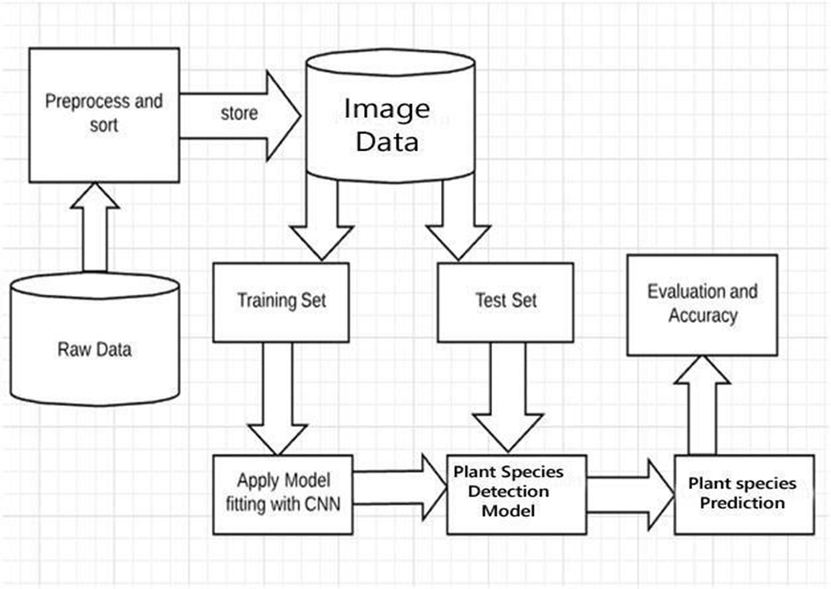
Proposed system architecture

Slide 16
Proposed Methodologies
Instead, the image data set is collected whit different plant names then after that feature extraction is done. Using deep learning we train to get new image and whenever new image is provided, we try finds new species of the plant. Thus, the prediction is Done using Machine Learning .
Proposed system features are:
1.User Interface - A UI is created to enable uploading of image(s) in which the plant species are to be detected.
2.Reduced Human Errors - Using a machine drastically reduces chances of errors by human errors.

Slide 17
Performance Measure:
The performance of the developed applications can be calculated by using following
methods:
Measuring enables you to identify how the performance of your application stands in relation
to your defined performance goals and helps you to identify the bottlenecks that affect your
application performance. It helps you identify whether your application is moving toward or
away from your performance goals. Defining what you will measure,that is, your metrics,
and defining the objectives for each metric is a critical part of your testing plan.
Performance objectives include the following:
Response time or latency
Throughput
Resource utilization

Slide 18
Result Analysis
1.Data preparation: Gather a dataset of plant images with corresponding species labels.
2.Training the ML model: Use the dataset to train the ML model, employing techniques like
convolutional neural networks (CNNs) for image recognition.
3.Model evaluation: Assess the trained model's performance using a separate validation
dataset or through cross-validation techniques.
4. Accuracy assessment: Measure the model's accuracy by comparing its predicted labels
with the ground truth or expert-verified labels.
5. Performance metrics: Calculate evaluation metrics such as precision, recall, F1 score,
or area under the curve (AUC) to quantify the model's effectiveness.
6.User feedback and validation: Gather feedback from users or domain experts to validate
the model's accuracy and usability, making necessary improvements based on their
input.

Slide 19
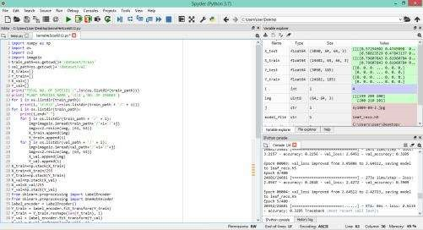
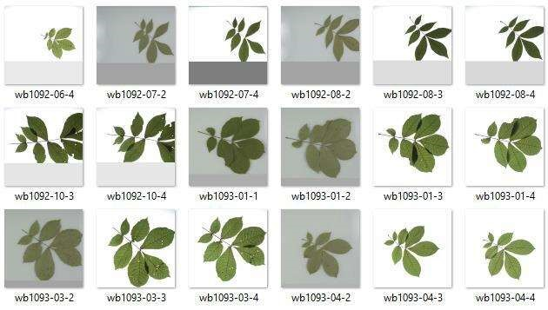
fig 1.1
fig1.2

Slide 20
Conclusion
Various techniques were used to predict the plant species in a metastatic image, based on visual observation and human experience, these predictions were often not very accurate.
However, in recent years, with the advancement in technology, it has been possible to study metastatic images correctly using machine learning techniques namely Convolution Neural Networks and NasNet.
In our project, we implemented these algorithms to predict the plant species by training the machine using a large dataset of collected metastatic scans and determined the roc curve for the best working algorithm.

Slide 21
Future work
The developed system is a basic approach at the problem of identification of plant species. The accuracy of the system can be improved upon to provide more accurate information about using other features. The code can also be turned into a python executable file such that it can be easily installed and used on any system.
In order to improve the accuracy other highly efficient Neural Network algorithms like DenseNet, MobileNet can be used .But these require high end processors and cost of project increases.
To make this project highly efficient, other rare plant species and data images can be added to the dataset.By this the accuracy of the algorithm increases and training time of model decreases making the project more efficient.

Slide 22
References
https://www.analyticsvidhya.com/blog/2021/05/convolutional-neural-networksunderstand-the-basics/
https://towardsdatascience.com/a-comprehensive-guide-to-convolutional-neuralnetworks-the-eli5-way-3bd2b1164a53
https://ieeexplore.ieee.org/document/7411268

Slide 23
Thank You!

